Slide 1
TRADING USING SENTIMENT ANALYSIS
Made By Vivek Ray
Roll No-PC24

Slide 2
Facts:
There were 14 million twitter users in India at the end of 2019 alone, with numbers and tweets per sec increasing.
As per January 2018 data, there are 389 News Channels (All language together) in India.
In a single day, thousands of blog posts are written by these News Channels making a single person inefficient to even have a glance at all.
Trading once assumed to be a profession of gambling has slowly turned into a battlefield of Information.
Only those who catch with its speed can make more in this age.

Slide 3
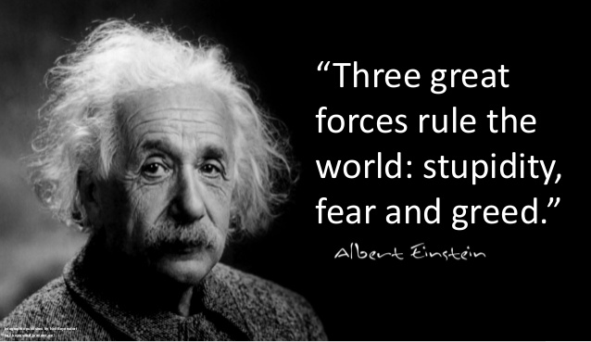
In Intra-day Trading, sentiments are gauges for Stock Markets to understand the future.

Slide 4

Traditional trading vs Automated Training(Using ML)

Slide 5
Introduction
The project aims to find the sentiments around the Stock in order to prove its reliability for trading and thus volume(number of stocks) bought/sold will be high.
For Example :
Yes Bank Stocks have a very negative public sentiments ,thus while trading the volumes of stock bought will be very less.
Reliance Industries on the other hand has highly positive public sentiments ,thus volume per trade will be high.

Slide 6
Requirements
Pandas - To read csv files & process data into data frames
Tweepy - To fetch search data from twitter.
Newsapi - To fetch news data from news portals
Seaborn - For Visualization of Graphs
Textblob - For Sentiment Analysis Of Twitter and News Data
Dateutil - To format date and time data

Slide 7
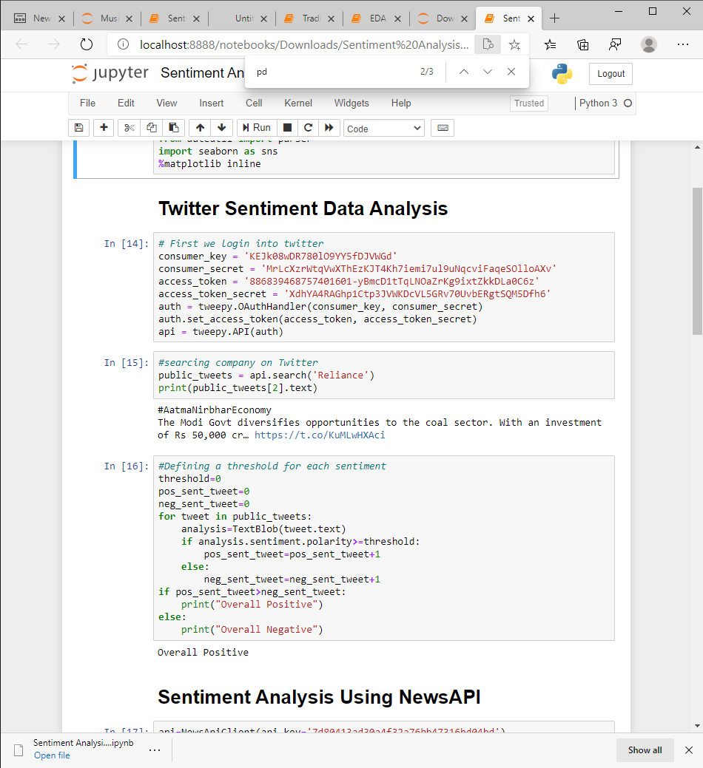
Data Used For sentiment Analysis
Twitter Search Data-

Slide 8
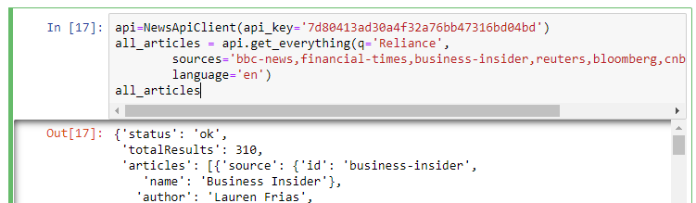
Data Used For sentiment Analysis
News Search Data-

Slide 9
After sentiment Analysis
Twitter Sentiment Analysis-

Slide 10
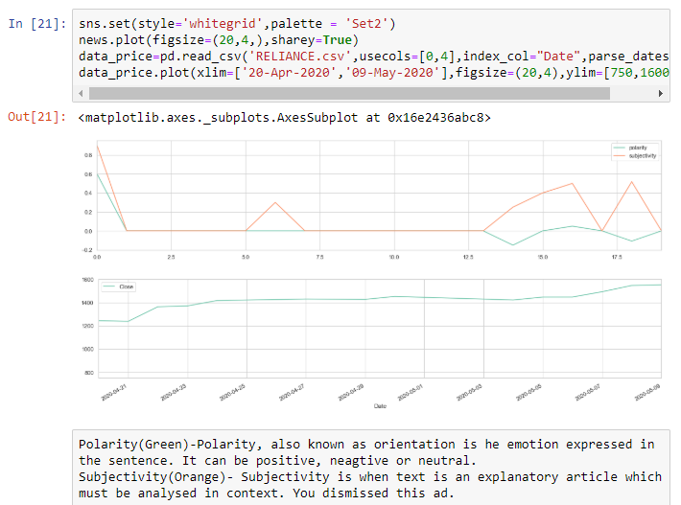
After sentiment Analysis
News Sentiment Analysis-

Slide 11
Challenges
Though it updates, us to the sentiments of users real-time yet, some decision require risky input for higher output.
Sentiments can be manipulated by fake whistle blowers or by fake news. Therefore, to get more reliable news source more money is required for authorization and use of intellectual property.
Real time operations require higher processing power with high-speed internet, reliable data and high interoperability skills of traders which can only come from experience.

Slide 12
Advantages with Using ML
Analysing news feed, twitter and several social media data within few clicks and seconds.
Gauging the sentiments around the trading stocks with reliable feeds from analysis
Can be further optimized with AI to ease the manual technical process.
Placing trades on the stocks in fraction of seconds with the automated process.

Slide 13
Thank You

